Slide 1

OOPL PROJECT
ABV-INDIAN INSTITUTE OF INFORMATION TECHNOLOGY AND MANAGEMENT, GWALIOR
SUBMITTED BY:-
HARSHIT SINGH (2020BCS-039)
KARTIK SINGH (2020BCS-045)
LAKSHYA GUPTA (2020BCS-049)
SAMMYAK HEMANT GADEKAR (2020BCS-066)
ANISH KUMAR THAKUR (2020BCS-076)
SUBMITTED TO:-
Dr. VINAL PATEL

Slide 2

STUDENT-GRAM
Social Networking Application

Slide 3
INTRODUCTION
The project is all about connecting various people around the globe with each other by virtual means. The user can contact anyone with just a click on the mouse.
This program will provide the following things:
♦ An option to create a new account for new users, while an option to login for old users.
♦ To search for your friends and check if they are here on the application as well.
♦ To follow your friends who are on the application.
♦ To exchange messages between your friends.
The user can access any person’s complete details, if he/she follows them. The project provides a friendly interface to the user so that it is easy for any user to use this program to its full extent.
The project makes a use of following different features of OOP:
♦ Inheritance.
♦ Classes and Objects.
♦ Function Overloading.
♦ Constructors.
♦ Friend Function.
♦ Operator Overloading.
♦ File Handling.

Slide 4
DESCRIPTION
In this project, we have many functions to manage everything separately as well as neatly.
This project includes one class of user which contains his/her username, password, number of followers and number of people following him/her.
Other function includes password_change() and rate() which helps in changing of user’s password and in rating of the application respectively.
There is another function message() which is used for sending/receiving messages between two users.
The application also involves file handling at a good level.

Slide 5
CLASSES AND FUNCTIONS
CLASSES :
We have a class named -- Info
Data Members -- Username , Password , Followers , Following .
The constructor here initiates the Followers and Following to 1 as soon as an account is Created.
We create object of the above mentioned class and perform various functions using the below defined functions.
FUNCTIONS :
-> void message(void) - To Initiate Messaging
-> void receive(void) - To View Received Messages
-> void send(void) - To Send Messages
-> void after_login(void) - To Redirect to Feed
-> void Rate(void) - To Rate the App
-> void follow(void) - To Initiate Following
-> void search(void) - To search a User
-> void password_change(void) - To Change Password
-> void view_profile(void) - To view Your Profile

Slide 6
RESULTS

Slide 7
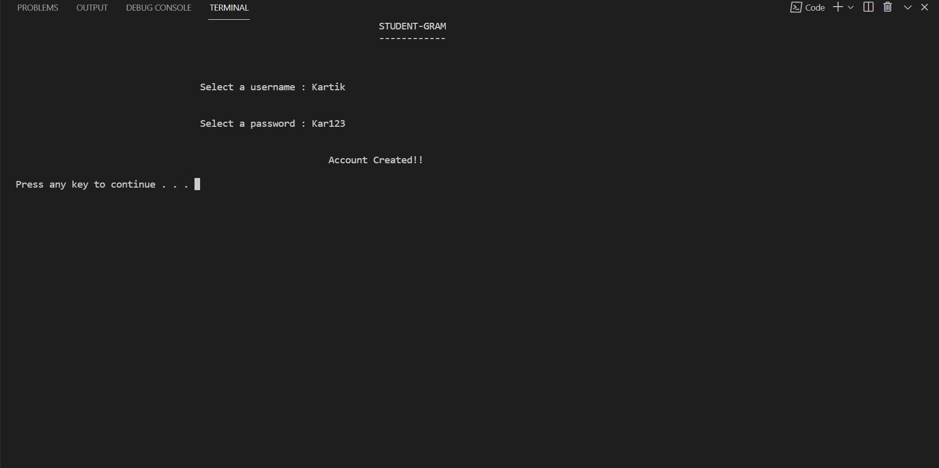
Logging In

Slide 8
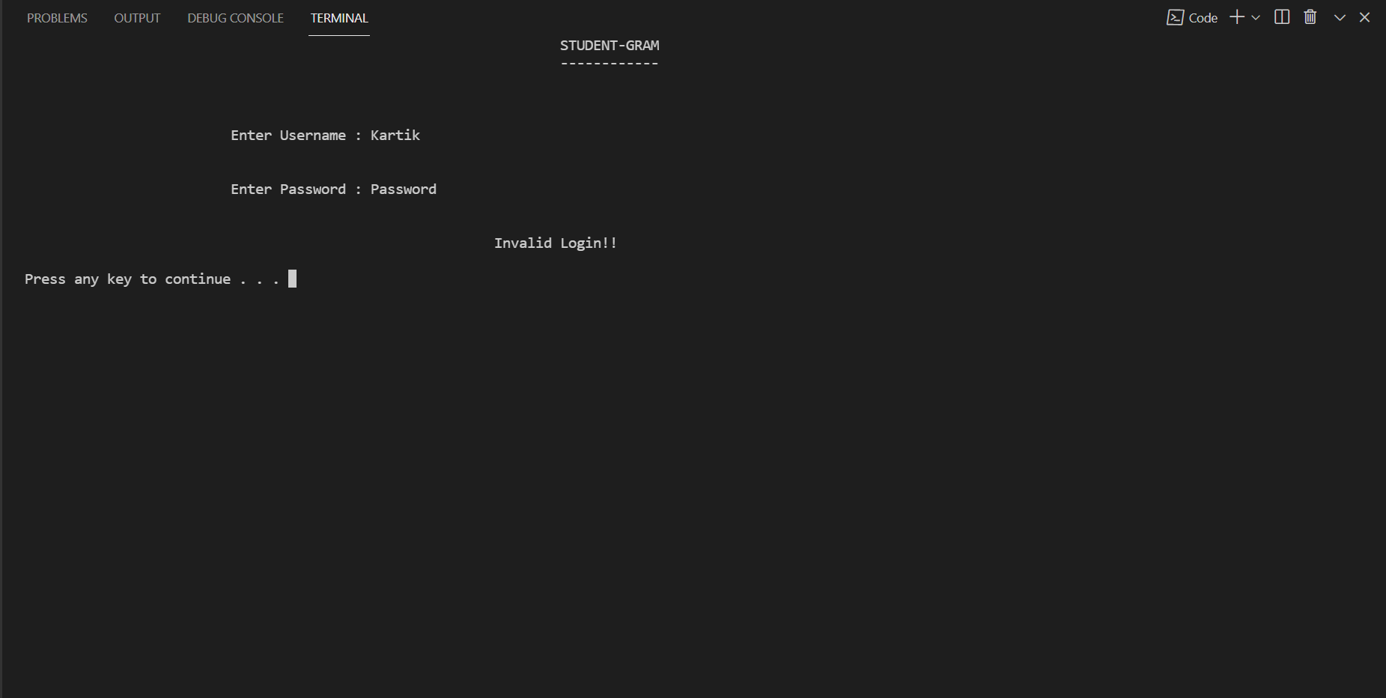

Slide 9


Slide 10
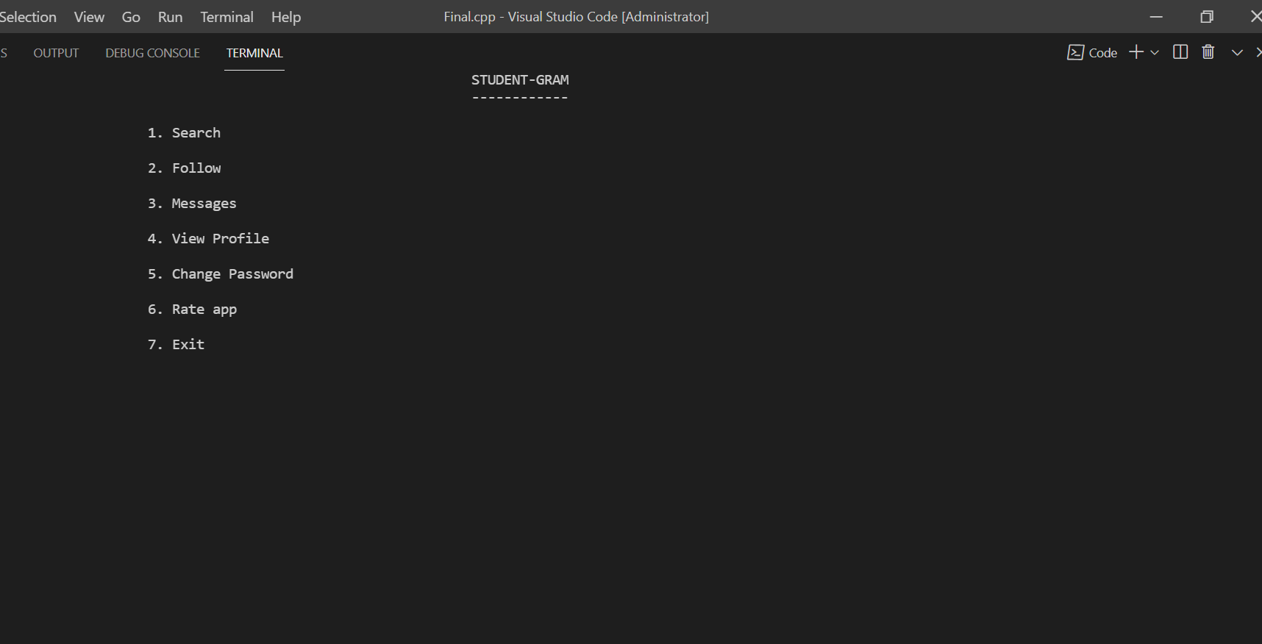
Main Page

Slide 11
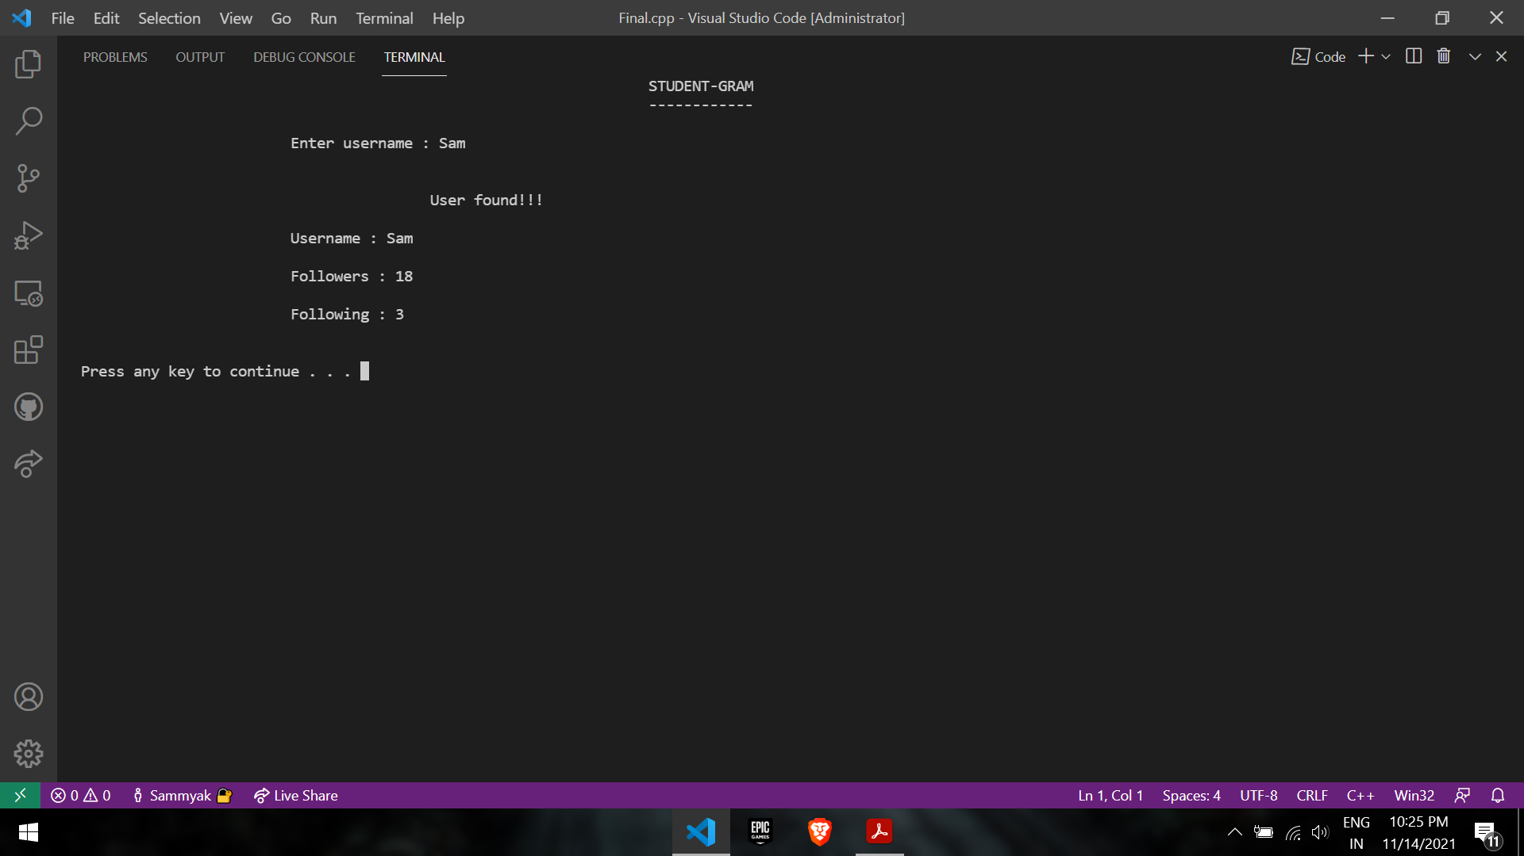
Searching User

Slide 12
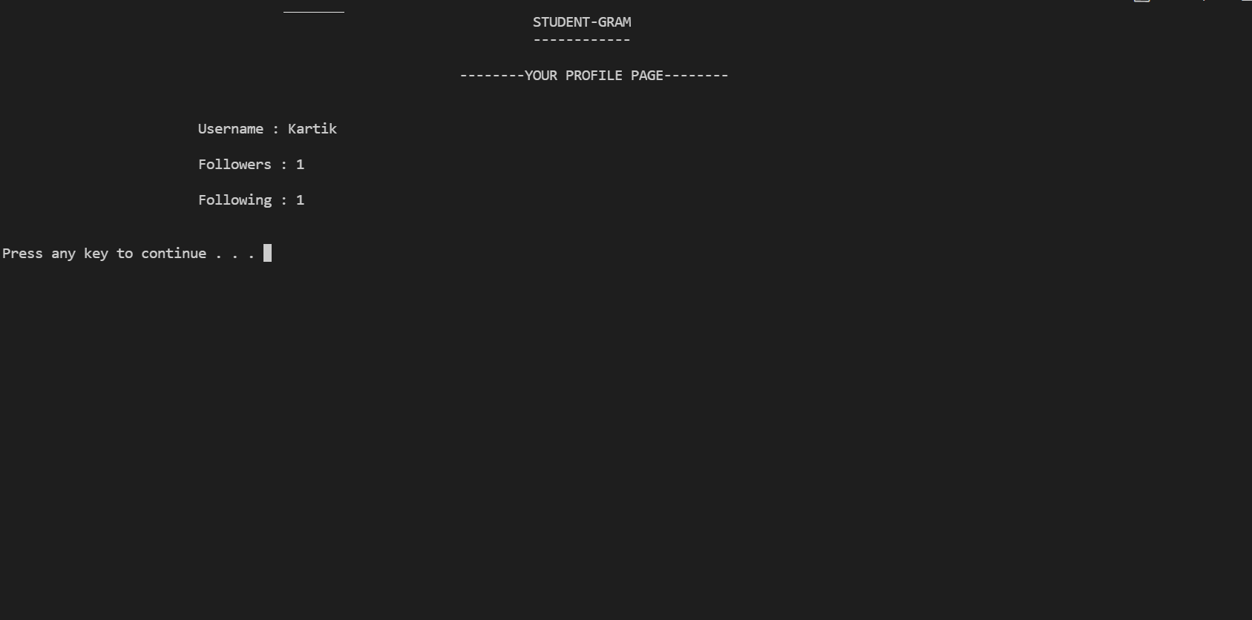
To View Own Account

Slide 13
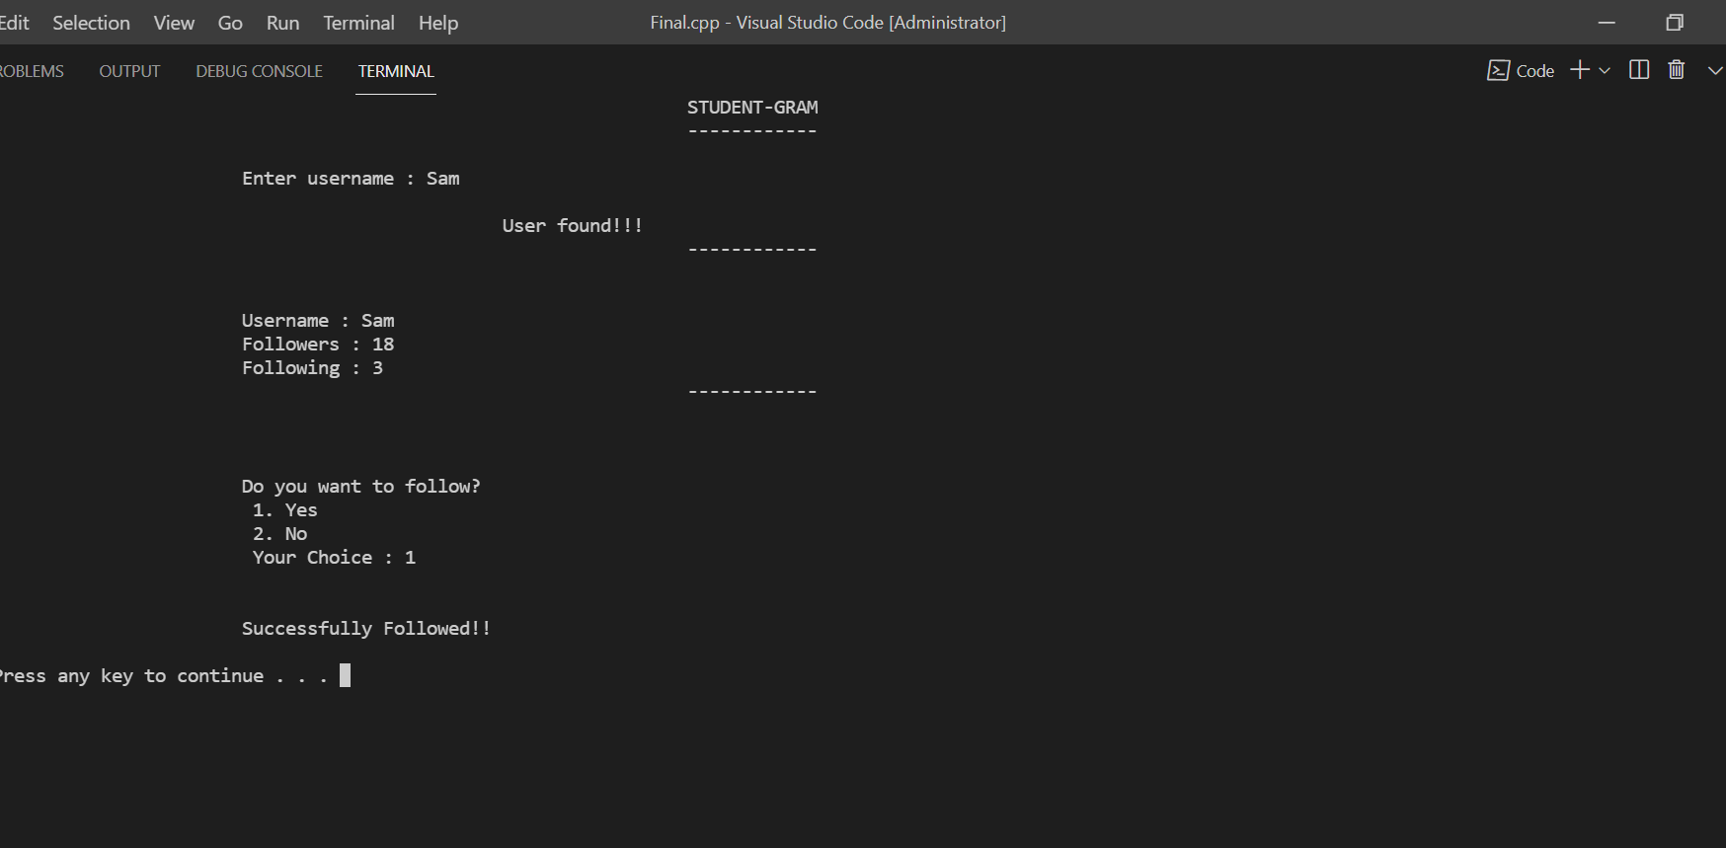
Following

Slide 14


Slide 15

Messaging (Sending & Receiving )

Slide 16
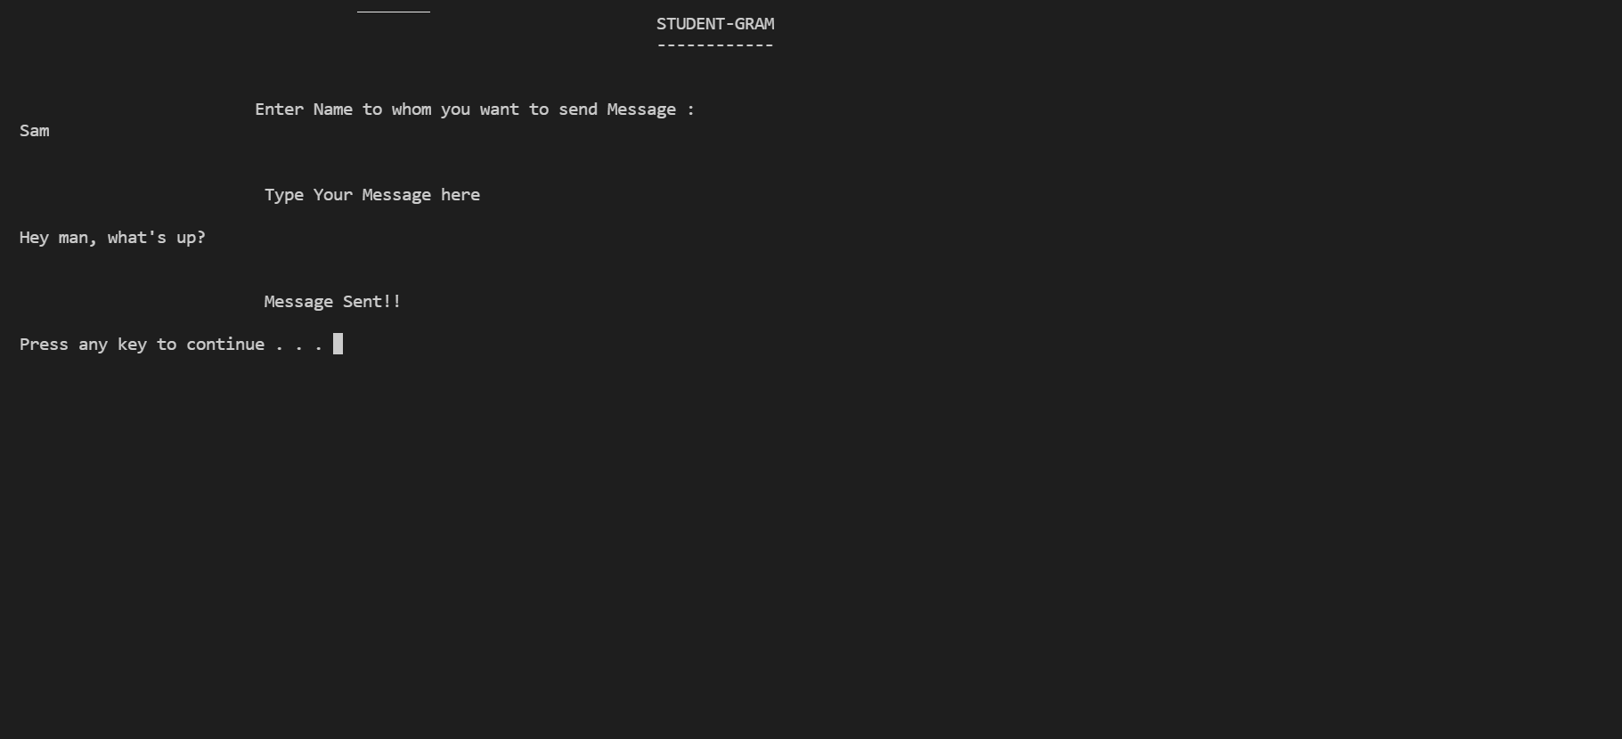
Sending Message

Slide 17
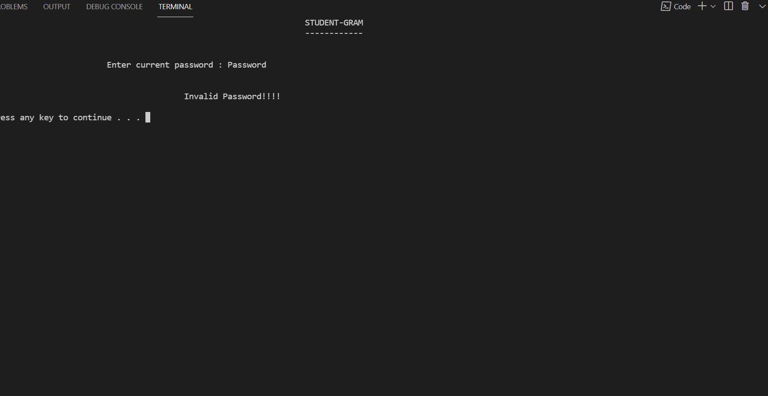
Changing Password

Slide 18
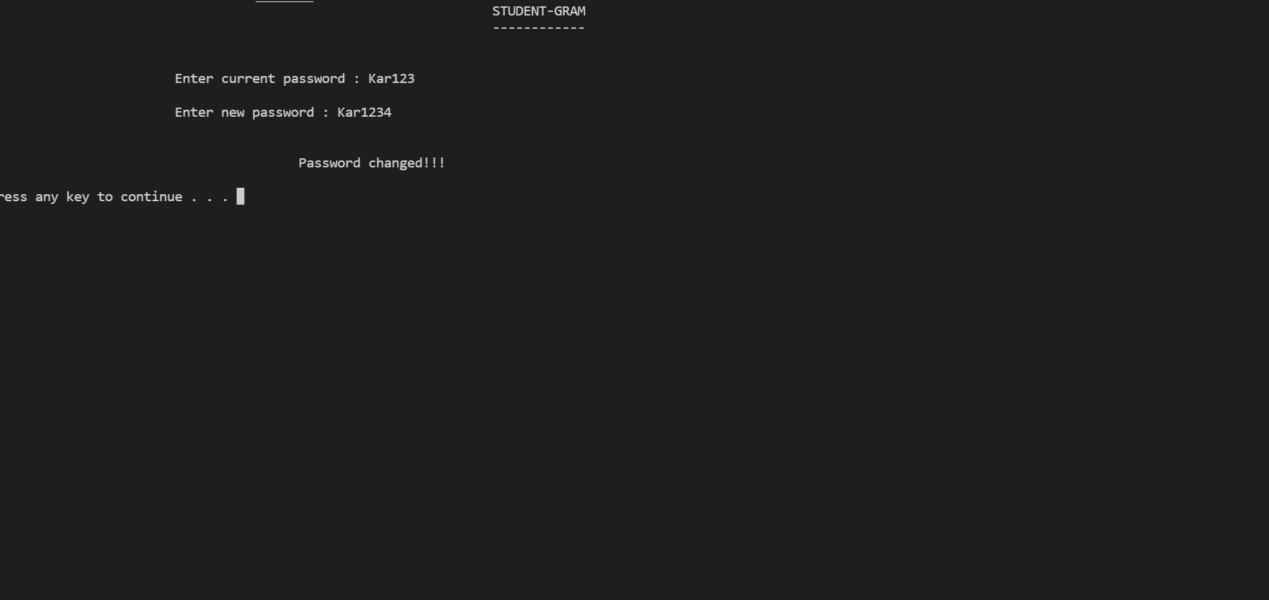

Slide 19
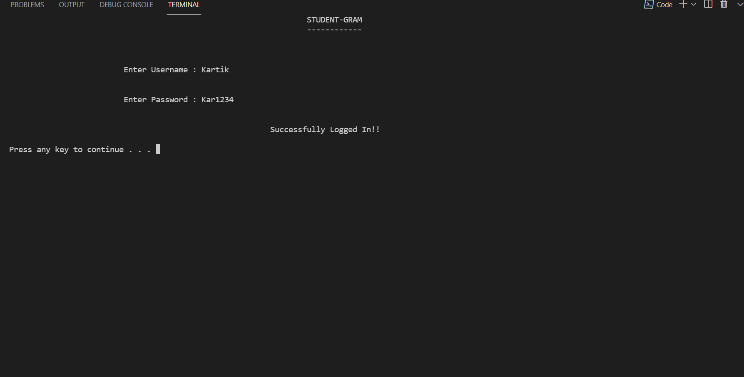

Slide 20
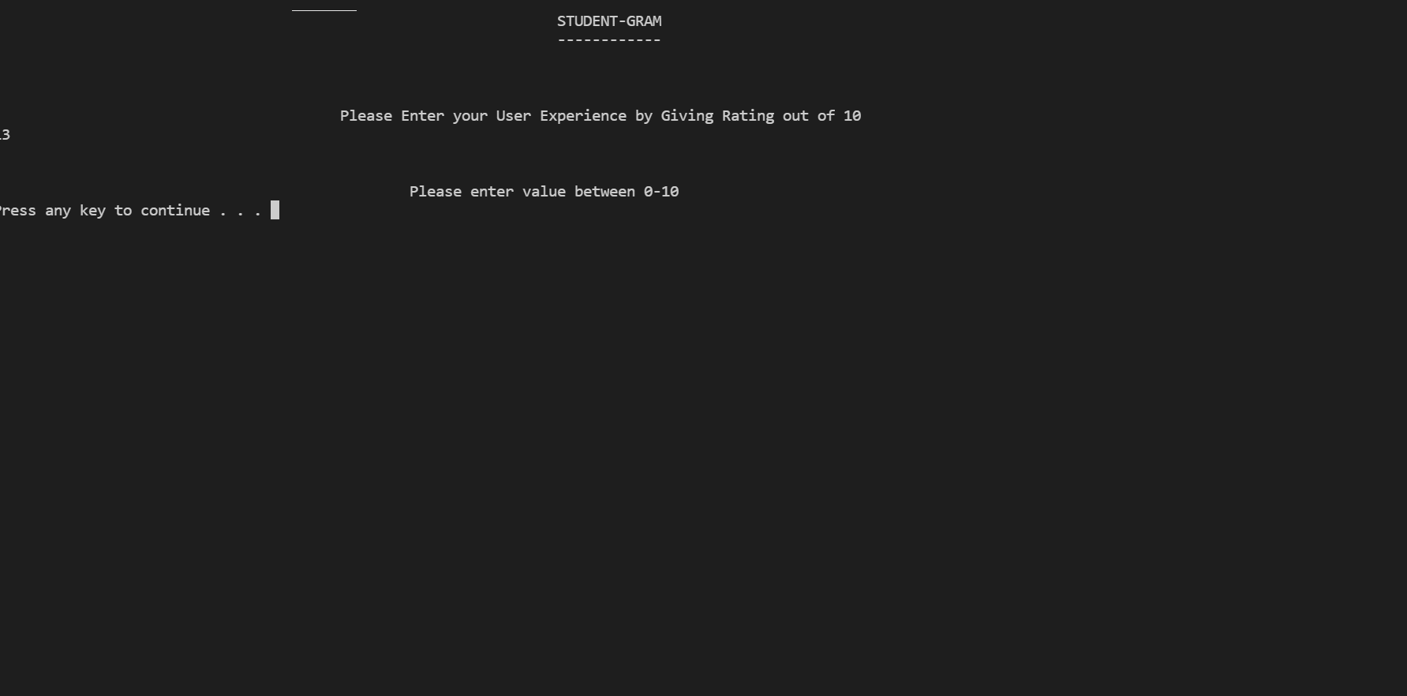
Rating The Application

Slide 21


Slide 22

Received Messages

Slide 23
CONCLUSION
At last, we’d like to conclude that This Social Media Application can prove to be of great importance in real world, where people can follow other and even share their thoughts through messages. This will also help user by giving them an option to Change their password so as to increase the security. People can influence others to follow them, gain followers and become Famous. Searching. following and Messaging is Highly Optimized to meet the need of the users.

Slide 24
THANK YOU

